Slide 1

Data Engineer Architecture
End-to-End Enterprise Data Pipeline, Graph Asset Hierarchy & Analytical Modeling Strategy
Role: Data Engineer

Slide 2

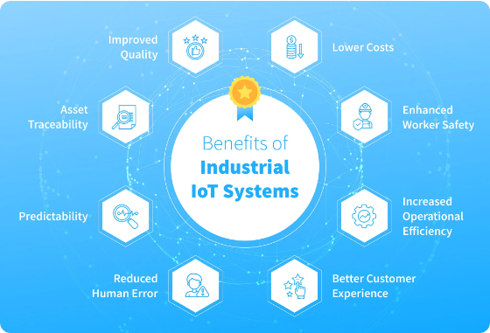
Scalable Ingestion & Pipeline Design
•
High-Volume Ingestion: Kafka & AWS Kinesis decouple real-time IoT sensors (temp, humidity, energy, fault logs) from downstream engines.
•
Medallion Data Architecture: Structured into Bronze (Raw Telemetry), Silver (Cleaned & Validated), and Gold (Aggregated Metrics) layers.
•
Batch & Streaming ETL: Spark Structured Streaming handles continuous aggregations, while Airflow orchestrates daily batch jobs.
•
Multi-Level Aggregation: Computes hourly energy use, daily asset utilization, site-level & building-level operational metrics.

Slide 3


Data Modeling & Graph Asset Hierarchy
Dimensional Star Schema
Multi-Asset Hierarchy (Graph Model)
Designed for analytical dashboarding, historical reporting, and downstream AI/ML models.
Models parent-child equipment relationships (Site → Building → Chiller → AHU → Sensors) using NetworkX / Neo4j.
•
Fact Tables: Telemetry Fact, Energy Fact, Event & Fault Fact.
•
Impact Analysis: Traverses tree nodes to isolate downstream affected equipment during failures.
•
Dimensions: Site, Building, Asset (AHU/Chiller/Pump), and Time Dimensions.
•
Graph Validation: Automatically detects orphan nodes and disconnected telemetry sensors across sites.
•
Optimization: Date-partitioned tables with B-tree indexing on asset_id & timestamp.

Slide 4






Data Quality & Pipeline Orchestration
Quality Framework
Airflow Orchestration
Error Handling & Alerts
Automated validation checks incoming telemetry for missing values, duplicate event keys, schema violations, late-arriving data, and statistical outliers before entering Silver storage.
DAGs manage pipeline dependencies, data backfills, and batch syncs. Implements exponential backoff retries, SLA tracking, and dynamic task mapping across site assets.
Invalid records are routed to a Dead-Letter Queue (DLQ) for inspection. Real-time alerting triggers via Webhooks on critical fault clusters or abnormal power surges.

Slide 5




Operational Analytics & API Integration
100%
< 24h
3 Endpoints
Pipeline Coverage
Outage Detection
REST API Layer
Ingestion, Validation & Storage
Automated Inactive Sensor Alerts
Sites, Assets & Health Telemetry
Challenge Requirement | Implementation Approach | Status / Deliverable
Energy & Fault SQL Queries | Calculates top 10 energy consumers, site averages & 30-day fault triggers | Completed (SQL)
Hierarchical Asset Queries | Recursive CTEs & NetworkX graph queries for parent/child traversal | Completed (Graph)
Dashboard / API Layer | Streamlit UI for telemetry metrics + FastAPI REST endpoints | Completed (API/UI)

Slide 6
THANK YOU

